Slide 1
Chapter 25
Building a Web Service

Slide 2
What is a Web Service?
A Web Service is a class that that resides on a Web Server and service requests, just like an ASP application.
The difference is that the Web Service does not furnish HTML pages to the client. Instead, it behaves like a function: clients call the function by name, pass arguments (if needed) and get back a result.
The result can be a number, a string, an object like a DataSet, or an image.
Hence, a Web Service can be defined as a class that exposes methods, which are in effect functions.
Any other program that knows about the web service and has the proper permission can call these methods from anywhere on the web.

Slide 3
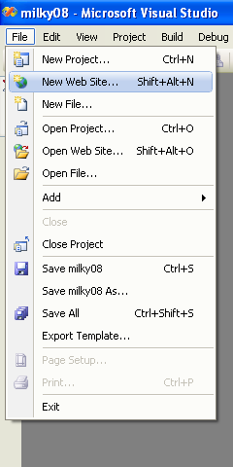
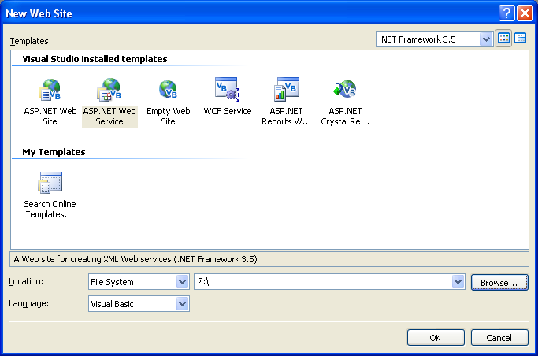
Getting Started

Slide 4
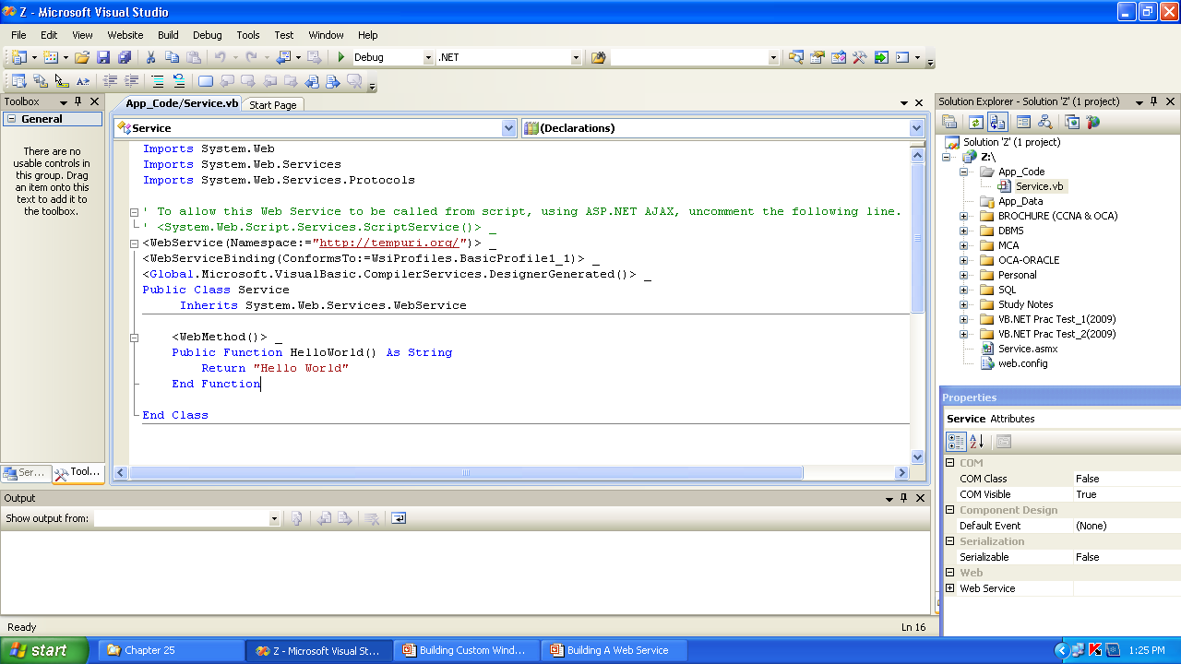
Web Service Source Code Page

Slide 5
Note
To get to the Service.vb page for writing the code, right–click on Sevice.asmx from the Solution Explorer Window and choose the option View Code
To run: Press Ctrl+F5

Slide 6
Building a Web Service
Imports System.Web
Imports System.Web.Services
Imports System.Web.Services.Protocols
Public Class MasteringService
Inherits System.Web.Services.WebService
<WebMethod()> _
Public Function Add(ByVal a As Decimal, ByVal b As Decimal) As Decimal
Return (a + b)
End Function
<WebMethod()> _
Public Function AddMultiply(ByVal a As Decimal, ByVal b As Decimal) As Decimal
Return (a * b)
End Function
End Class

Slide 7
The <WebMethod()> _ Tag
Prefix each method’s definition with the following tag:
<WebMethod()> _
The <WebMethod()> tag tells the compiler that the specific method is to be exposed to HTTP requests.
If this tag is not provided before a function, it will not be accessible to the clients

Slide 8
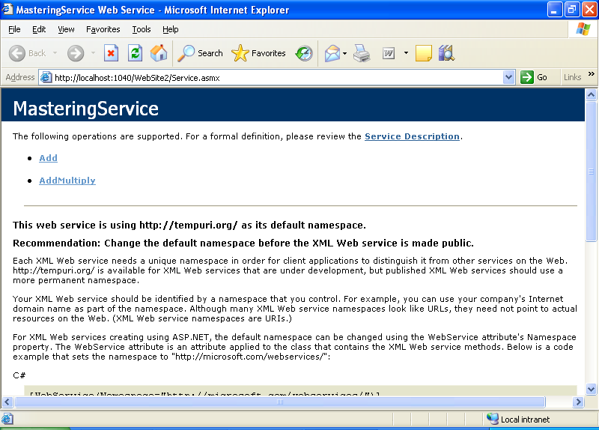
Testing the Web Service

Slide 9
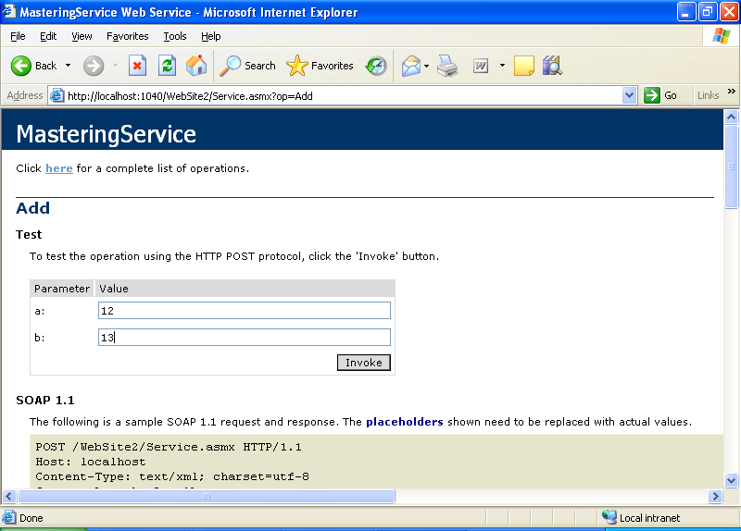
Connecting to a Web Service by a Browser

Slide 10
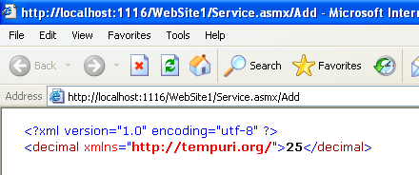
Input Page
Output Page

Slide 11
Consuming the Web Service
Start a new Windows Application Project and place a Button control on its form.
To access the members of a Web Service, we must add a reference to it. Project>Add Service Reference… command.
When the Add Web Reference dialog box appears, enter the URL of the ASMX file in its address bar.
Close the dialog box and return back to the project.
Then insert the following code in the button’s click event handler

Slide 12
Consuming the Web Service
The code to be inserted in the button’s click event handler:
Here, ws is an object which exposes any Web Methods of the Web Service
Public Class Form1
Private Sub Button1_Click(.. … … …) Handles Button1.Click
Dim ws As New ServiceReference1.ServiceSoapClient
MsgBox(ws.Add(20.0, 30.1))
End Sub
End Class

Slide 13
Alternative
Public Class Form1
Private Sub Button1_Click(.. … … …) Handles Button1.Click
Dim ws As New ServiceReference1.WebServiceSoapClient
MsgBox(ws.Add(20.0, 30.1))
End Sub
End Class

Slide 14
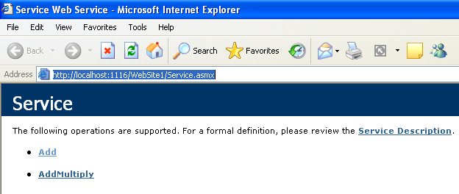
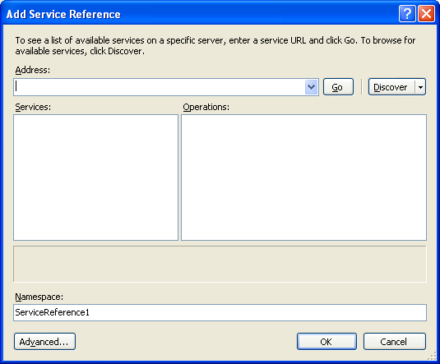
Adding Web Service Reference in Windows Application

Slide 15
Note
The URL is copied from the browser, it is the URL which is present in the browser when the web service is tested
In the Add Service Reference, the name of the service object can be changed before adding, it is ServiceReference1 by default
The web service must be running for the windows application to be able to have access to the services.

Slide 16
For Security Exception
Go to Project Menu and click on Your Window Application Name Properties e.g. WindowApplication1 Properties Option
Then Choose the Security Tab on the left of the Properties Page
Check Enable
Then run the application

Slide 17
SOAP
The Simple Object Access Protocol (SOAP) is a protocol that defines a vocabulary for communication between computers.
More specifically, SOAP defines a way for requests and responses to be exchanged.
The .NET Web services uses SOAP for communication between client and service.

Slide 18
The Loan Web Service
Imports System.Web.Services.Protocols
<WebService(Namespace:="http://tempuri.org/")> _
<WebServiceBinding(ConformsTo:=WsiProfiles.BasicProfile1_1)> _
<Global.Microsoft.VisualBasic.CompilerServices.DesignerGenerated()> _
Public Class LoanService
Inherits System.Web.Services.WebService
<WebMethod()> Public Function Loan(ByVal Amount As Decimal, ByVal Duration As Integer, ByVal Rate As Decimal, ByVal PayEarly As Boolean) As Decimal
If Rate < 0 Then
Throw New Exception("Interest rate can't be negative!")
End If
If Rate < 1 Then
Rate = Rate / 12
Else
Rate = Rate / (12 * 100)
End If
Return Pmt(Rate, Duration, Amount, 0, PayEarly)
End Function
End Class

Slide 19
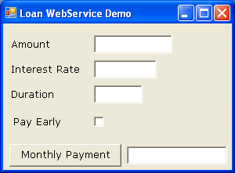
Building A Web Service Project
txtPayment
... ...
… …
txtPayment.Text = ws.Loan(amount, duration, rate, payEarly)

Slide 20
Designing Applications
Preferred to return the result from the Server, that is the returning value from the function, to another control to display result rather than a MsgBox() as shown in above example.
MsgBox(), is usually used for testing and displaying error messages to the user

Slide 21
Work Sheet
Create a Web Service application that exposes three methods for performing three different tasks which are as follows:
  Finding the Simple Interest based on the values of Principal, Rate of interest and Time (in years), supplied at run-time
  Finding the sum of the Fibonacci series up to ‘n’ terms, where the value of ‘n’ is send at run-time.
  Finding the Factorial a number ‘n’, where the value of ‘n’ is send at run-time.
Now, design a Windows Application Project that has multi-forms for performing each of the above calculations.
Add a reference to the above web service project and display the results accordingly.

